Slide 1
HYBRIS: Cache week 7
Task 7.6 - (Cache):
Task 1: Find out how to clear all cache regions using HAC.
Implement the following tasks programmatically (using Hybris cache API):
invalidation of certain item
clear particular region (Entity region)
clear all regions at the same time

Slide 2
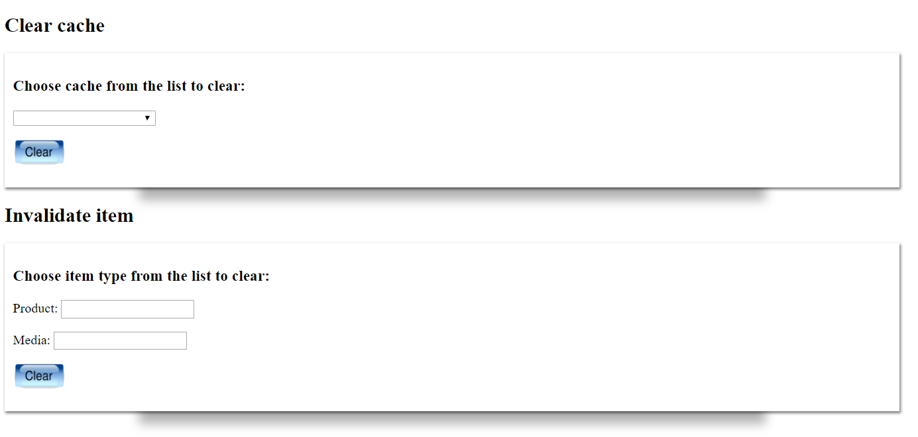
To invalidate items and to clear caches I built up a UI with a forms where the user is able to give the parameters and fire the actions.
Implementation details

Slide 3
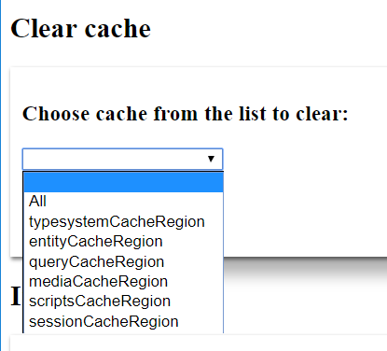
The form of clear cache contains a prepopulated drop-down list with the available cache regions. After choosing one of them the user is able to clear the cache. I used the de.hybris.platform.regioncache.region.CacheRegionProvider class to get the cache regions. Once a cache gets selected, I invoked its clearCache method.
Implementation details – clear cache

Slide 4
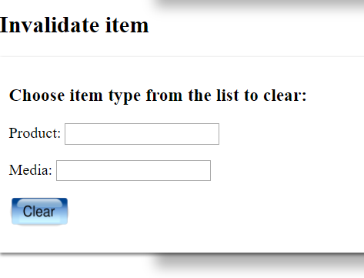
My solution is able to invalidate products and medias only. The user is able to give the name/code of the media and the product they want to invalidate. I look up the product/media with de.hybris.platform.servicelayer.search.FlexibleSearchService Once I found the item, I invoke the invalidateCache(PK) method of the de.hybris.platform.util.Utilities class.
Implementation details – invalidate items

